Slide 1
Summary of Findings The Cluster Commanders
05/01/2025
1

Slide 2
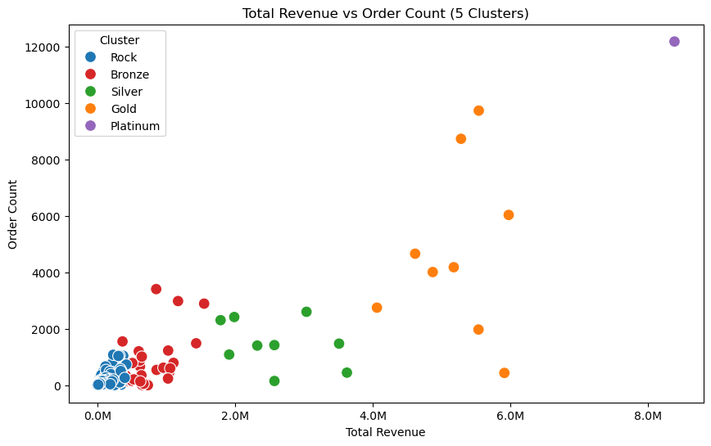
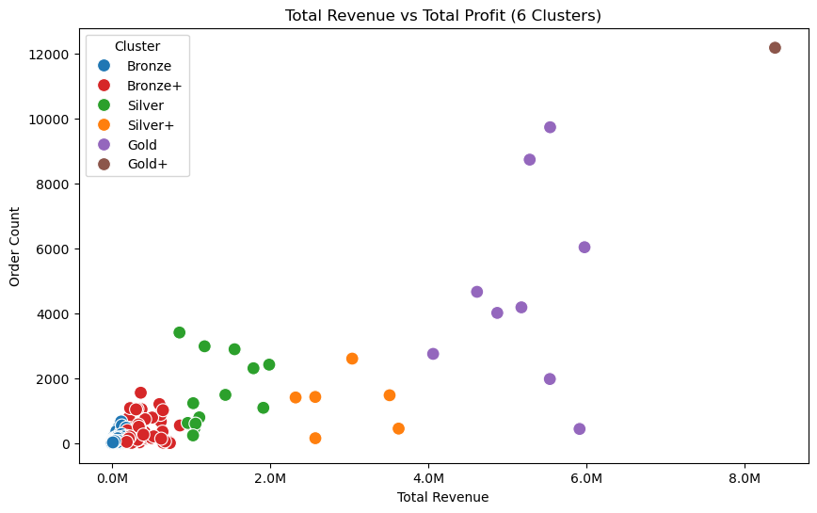
Model Results – K-means
Silhouette Score:
.886 (2nd)
Davies-Bouldin Index
.490 (1st)
Calinski-Harabasz Index
4258 (1st)
18

Slide 3
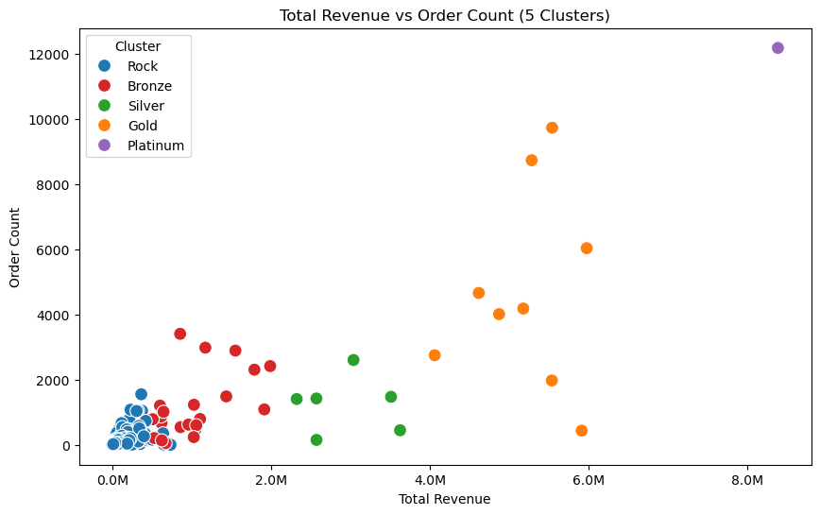
Model Results – Hierarchal Model
Silhouette Score:
.889 (1st)
Davies-Bouldin Index
.513 (2nd)
Calinski-Harabasz Index
3845 (2nd)
19

Slide 4
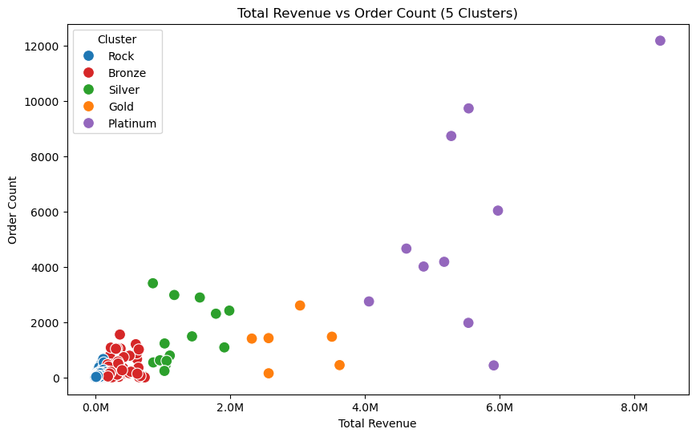
Model Results – Fuzzy Cmeans
Silhouette Score:
.804 (3rd)
Davies-Bouldin Index
.618 (3rd)
Calinski-Harabasz Index
3638 (3rd)
20

Slide 5
Model Results – Markov-Chain
Silhouette Score:
.804 (3rd)
Davies-Bouldin Index
.618 (3rd)
Calinski-Harabasz Index
3638 (3rd)
20

Slide 6
Model Results – Monthly Aggregate Prediction
Methodology: Using a time series of customer purchases on a monthly basis
Using Ensembled model of random forest and Light Gradient Boosting Machine for prediction
Scores:
Accuracy: 96%
Macro F1-score: 0.57
Weighted F1-score: 0.94
NOTE: over 90% of the customers were classified in the bronze tier which is why the accuracy scores are high
20

Slide 7
Customer Highlights
Understanding Our Customers:
We grouped customers into 6 tiers from Rock (lowest) to Platinum (highest).
Most customers are in Tier 0 (Rock), but they bring in very little revenue.
Tiers 4 and 5 (Diamond and Platinum) have fewer customers but the highest revenue.
What We Learned:
Customers don’t often move to higher tiers on their own — especially from Rock and Bronze tiers.
Our monthly aggregate prediction model is very accurate, which helps our client plan sales and marketing better.

Slide 8
Business Insights
Prioritize Silver and Gold — these customers show strong potential for growth and are most likely to upgrade with targeted engagement.
Retain Platinum and Diamond customers — these customers consistently contribute the highest revenue, despite being a smaller portion of the customer base.
Engage Rock & Bronze customers — these customers show minimal spending patterns, with limited movement into higher tiers, even over longer periods

Slide 9
Conclusion
Combining tier-based segmentation with predictive modeling gave us powerful insights into customer behavior—allowing our client to target the right customers, boost retention, and drive smarter growth decisions.

